Slide 1
Tail Recursion
An accumulating parameter

Slide 2
Computing a Sum on a recursive ascent
fun sum 0 = 0
| sum n = n + sum(n-1);
sum 3
→ 3 + (sum(3-1))
→ 3 + (sum(2))
Memory requirements are proportional to the size of the sum.
→ 3 + (sum 2)
→ 3 + (2 + sum(2-1))
→* 3 + (2 + (1 + (sum 0))
→* 3 + (2 + (1 + 0))
→* 6

Slide 3
Computing a Sum During the recursive descent
fun sum (0,acc) = acc
| sum (n,acc) = sum(n-1, n+acc);
sum (3,0)
→ sum(3-1,3+0)
→* sum(2,3)
Uses an accumulator to keep a running total.
→* sum(1,2+3)
→* sum(1,5)
→* sum(0,6)
→* 6
(1+(2+(3+0)))

Slide 4
(((0 + 3) + 2) + 1)
fun sum (0,acc) = acc
| sum (n,acc) = sum(n-1, acc + n);

Slide 5
Pros and Cons
Ascent-based computation
Descent-based computation
Growing memory requirements
Correctness proof based on induction.
Fixed memory requirements
More complex reasoning needed to prove correctness.

Slide 6
Reversing A List – A seminal example
fun reverse [] = []
| reverse (x::xs) = reverse xs @ [x];
list values (are immutable) and copies must be made of intermediate list values!!!
fun reverse ([],acc) = acc
| reverse (x::xs,acc) = reverse (xs, x::acc);

Slide 7
Wrapper Functions
fun reverse xs =
let
fun aux ([] ,acc) = acc
| aux (x::xs,acc) = aux (xs, x::acc)
in
aux(xs,[])
end;
reverse [1,2,3];

Slide 8
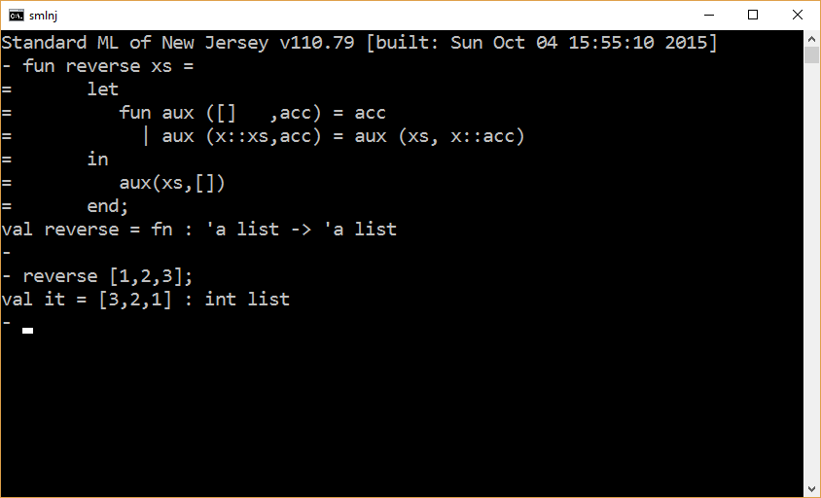

Slide 9
Example – For All Odd
fun isOdd x = x mod 2 = 1;
fun allOdd ([] ,acc) = acc
| allOdd (x::xs,acc) = allOdd(xs, isOdd x andalso acc);
allOdd ([1,3,5,7],true);

Slide 10
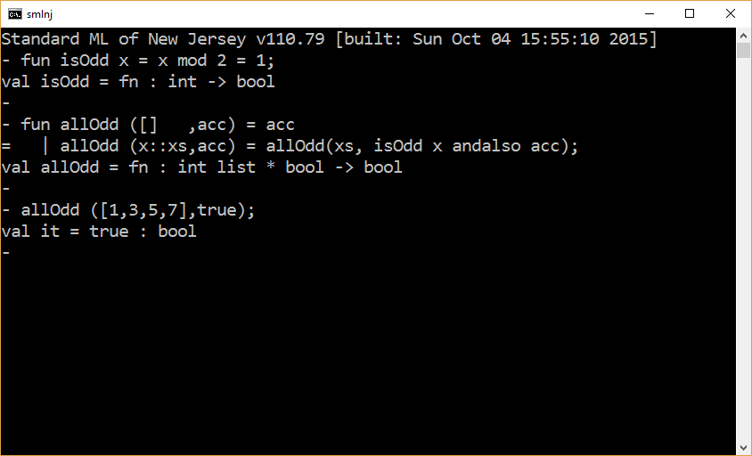

Slide 11
Example – For All Odd (improvement)
fun isOdd x = x mod 2 = 1;
fun allOdd ([] ,acc) = acc
| allOdd (x::xs,acc) = allOdd(xs, acc andalso isOdd x);
allOdd ([1,3,5,7],true);

Slide 12
Example – Exists Odd
fun isOdd x = x mod 2 = 1;
fun existsOdd ([] ,acc) = acc
| existsOdd (x::xs,acc) = existsOdd(xs, isOdd x orelse acc);
existsOdd ([2,4,5,8],false);
Note that the recursive call in the code above is not short-circuited.
fun isOdd x = x mod 2 = 1;
fun existsOdd [] = false
| existsOdd (x::xs) = isOdd x orelse existsOdd xs;

Slide 13
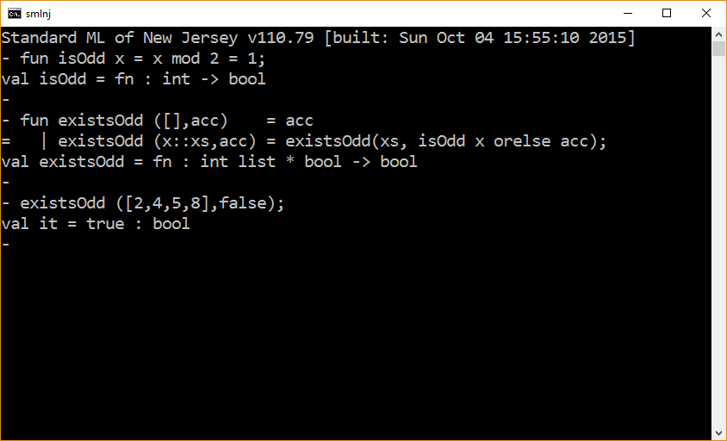

Slide 14
Example – Tracing Exists Odd
fun isOdd x = x mod 2 = 1;
fun existsOdd ([],acc) = acc
| existsOdd (x::xs,acc) =
(
print (“\nprocessing x = “ ^ Int.toString x);
existsOdd(xs, isOdd x orelse acc)
);
existsOdd ([2,4,5,8],false);

Slide 15
Example – Tracing Exists Odd with wrapper
fun isOdd x = x mod 2 = 1;
fun existsOdd xs =
let
fun aux ([],acc) = acc
| aux (x::xs,acc) =
(
print (“\nprocessing x = “ ^ Int.toString x);
aux(xs, isOdd x orelse acc)
);
in
aux (xs,false);
print “\n\n”
end;
existsOdd [2,4,5,8];
? value returned

Slide 16
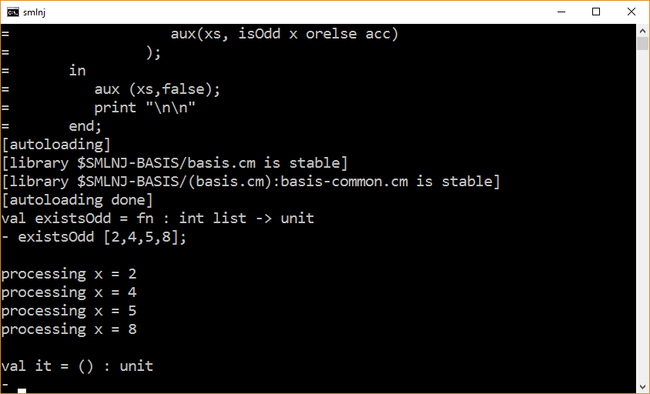

Slide 17
fun isOdd x = x mod 2 = 1;
fun existsOdd xs =
let
fun aux ([],acc) = acc
| aux (x::xs,acc) =
(
print (“\nprocessing x = “ ^ Int.toString x);
aux(xs, isOdd x orelse acc)
);
val result = aux (xs,false);
in
print “\n\n”;
result
end;
existsOdd [2,4,5,8];
return value is
computed here

Slide 18
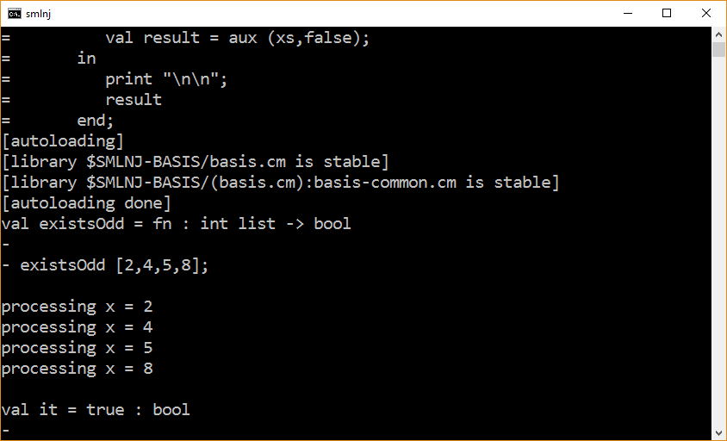

Slide 19
Example - Generate
fun generate 0 = []
| generate n = n :: generate (n-1);
fun generate (0,acc) = acc
| generate (n,acc) = generate (n-1, n::acc);
generate(10,[]);

Slide 20
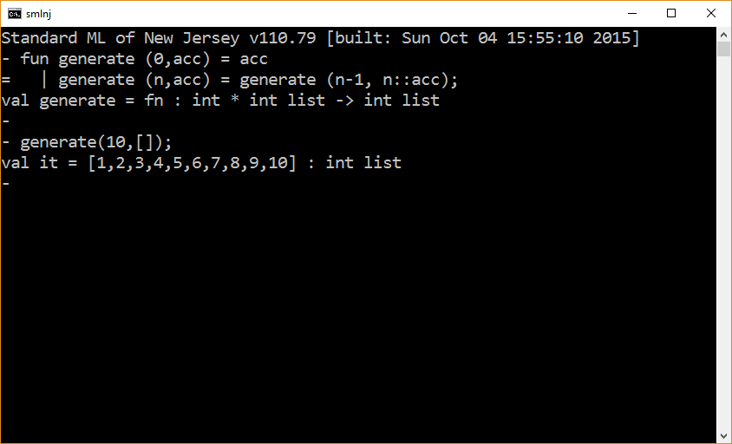

Slide 21
Example - Remove
(* assumes the elements in the list are unique *)
fun remove (_,[]) = []
| remove (x, y::ys) = if x = y then ys
else y :: remove (x,ys);
(* assumes the elements in the list are unique *)
fun remove (_,[] ,acc) = acc
| remove (x, y::ys,acc) = if x = y then acc @ ys
else remove (x,ys, y::acc);
remove (5,[1,2,3,4,5,6,7],[]);

Slide 22
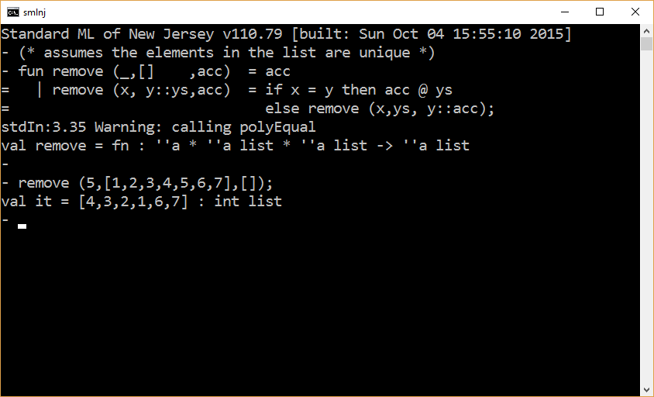
acc
ys

Slide 23
(* assumes the elements in the list are unique *)
fun remove (_,[],acc) = acc
| remove (x, y::ys,acc) = if x = y then rev(rev ys @ acc)
else remove (x,ys, y::acc);
remove (5,[1,2,3,4,5,6,7],[]);
(* assumes the elements in the list are unique *)
fun remove (_,[],acc) = acc
| remove (x, y::ys,acc) = if x = y then rev acc @ ys
else remove (x,ys, y::acc);
remove (5,[1,2,3,4,5,6,7],[]);

Slide 24
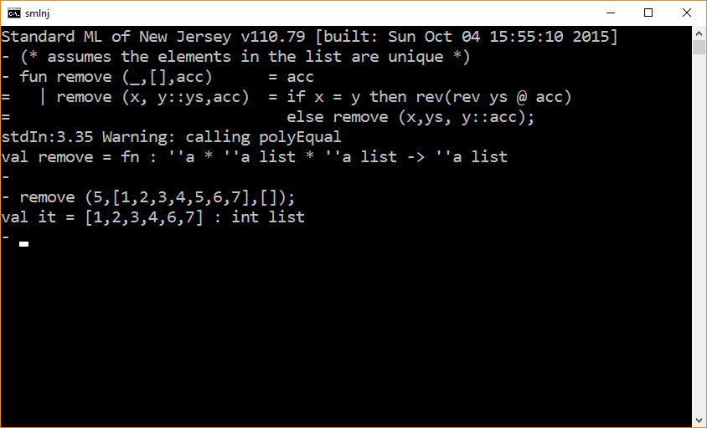

Slide 25
Example - ZIP
(* Precondition: lists have equal lengths *)
fun zip ( [] , [] ) = []
| zip ( x::xs, y::ys ) = (x,y) :: zip (xs, ys);
zip( [1,3,5],[2,4,6] );
(* Precondition: lists have equal lengths *)
fun zip ( [] , [], acc ) = rev acc
| zip ( x::xs, y::ys, acc ) = zip (xs, ys, (x,y)::acc);
zip( [1,3,5],[2,4,6], [] );

Slide 26
Example - unzip
fun unzip ( [] , list1, list2) = (rev list1, rev list2)
| unzip ( (x,y)::rest, list1, list2) =
unzip(rest, x::list1, y::list2);
unzip( [(1,2),(3,4),(5,6)], [], [] );

Slide 27
Validation
fun zip ( [] , [] ) = []
| zip ( x::xs, y::ys ) = (x,y) :: zip (xs, ys);
fun unzip ( [] , list1, list2) = (rev list1, rev list2)
| unzip ( (x,y)::rest, list1, list2) =
unzip(rest, x::list1, y::list2);
val xs = [ (1,2),(3,4),(5,6),(7,8),(9,10)];
zip(unzip(xs, [], [])) = xs;

Slide 28
The end

